Slide 1
Customer Cluster Identification Based on Influencer & Sentiment Analysis
Team 21
Zhou Zekai A0236594U/ Yan Yangchun A0242086H/
Wang Huiyi A0241637E/ He Wenbin A0237325H/ Luo Wei A0236571A

Slide 2
Contents
01.
Introduction
05.
Results
02.
Methodology
06.
Conclusion
03.
Data Sources
07.
References
04.
Process

Slide 3
01
Introduction

Slide 4
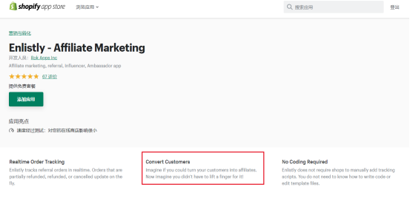
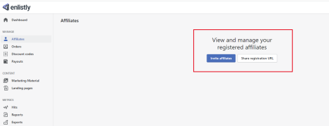
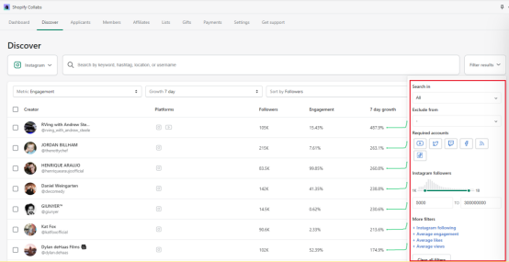
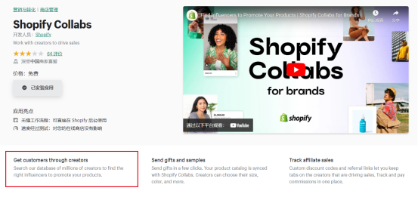
Introduction
complements the data gap between the two plugins and the pain points above:
perfecting the potential user base mined from influencers
serving the distribution selection

Slide 5
02
Methodology

Slide 6
Methodology
Influencer Identification
Community Detection
Sentiment Analysis
Degree Centrality
Eigenvector Centrality
PageRank
K-Means clustering
Hierarchical clustering AGNES
Bi-LSTM
CNN+LSTM+Attention

Slide 7
03
Data Sources

Slide 8
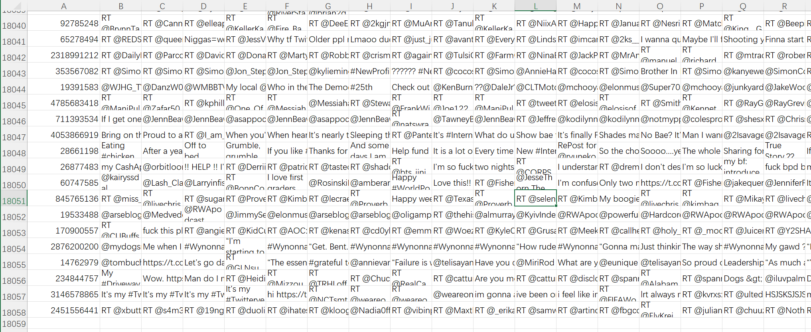
Data Sources
<Twitter Friends>
40k full Twitter user profile data (including who they follow)
通过爬虫获取推特API，以id、tweetID爬取了对应的用户的评论
id | user ID, this number can not change
screenname
tags | the hashtags (whith or without #) used by the user. It's the "trending topic" the user tweeted about
followerCount | the number of people following this user
friendsCount | the number of people following this user
tweetID | Id of the last tweet posted by this user
friends | the list of IDs the user follows (data stored is IDs of users followed by this user)
Sources: https://www.kaggle.com/datasets/hwassner/TwitterFriends

Slide 9
04
Process

Slide 10
Process
建立图模型找influencer
对followers的评论进行情感识别
发现有商业价值的follwers
数据预处理
获取followers
I know above the clouds the sun is shining. I design my future bright, not by where my life has been. Not until I do this will my new life start. Not until I do this will my new life start.

Slide 11
05
Results

Slide 12
06
Conclusion

Slide 13
References
[1] Vimali, J. S., & Murugan, S. (2021, July). A text based sentiment analysis model using bi-directional LSTM networks. In 2021 6th International Conference on Communication and Electronics Systems (ICCES) (pp. 1652-1658). IEEE.
[2] Zhang, Y., Zheng, J., Jiang, Y., Huang, G., & Chen, R. (2019). A text sentiment classification modeling method based on coordinated CNN‐LSTM‐attention model. Chinese Journal of Electronics, 28(1), 120-126.

Slide 14
Thanks
For you watching
CS5344 Team21

Slide 15
Concise
Style Template
Windows 10
Power Point 2013
Power Point 2013
Keynote 6.5
Not until I do this will my new life start. And say my thank yous to each and every moment of my life.
I know above the clouds the sun is shining. I design my future bright, not by where my life has been. Not until I do this will my new life start.
Google
Adobe
Illustrator

Slide 16
Concise
Style Template
Power Point 2013
I know above the clouds the sun is shining. I design my future bright.
Adobe
Google Chrome
I know above the clouds the sun is shining. I design my future bright.
Windows 10
I know above the clouds the sun is shining.
Keynote 6.5
Illustrator
I know above the clouds the sun is shining. I design my future bright.
I know above the clouds the sun is shining.

Slide 17
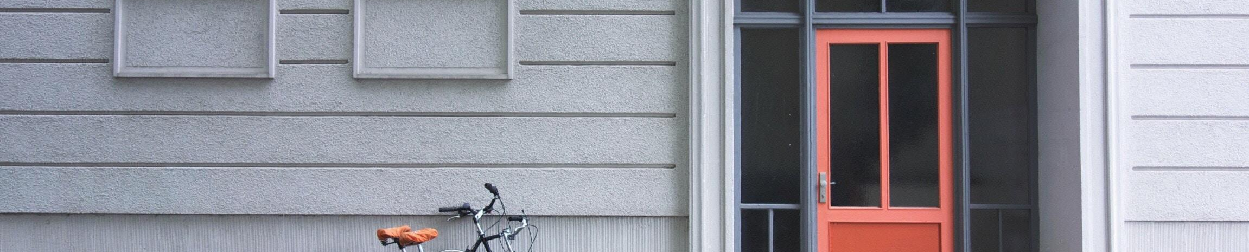
Concise
Style Template
Not Until I Do This Will My New Life Start. And Say My Thank Yous To Each And Every Moment Of My Life.
Power Point 2013
Keynote 6.5
I know above the clouds the sun is shining. I design my future bright.
I know above the clouds the sun is shining. I design my future bright.

Slide 18
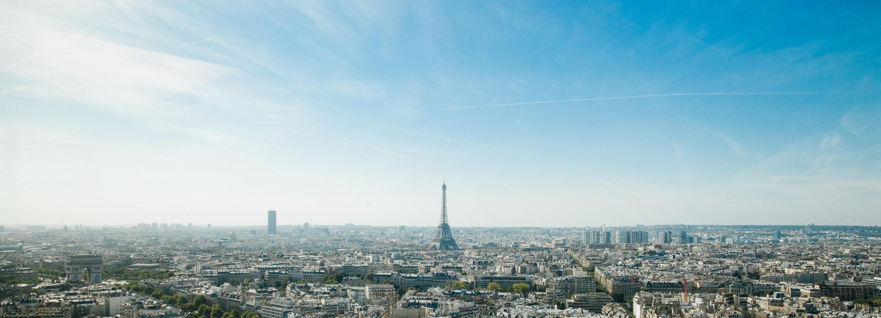
Our Global Reach
02
Not until I do this will my new life start. And say my thank yous to each and every moment of my life.
Two
POWERPOINT

Slide 19
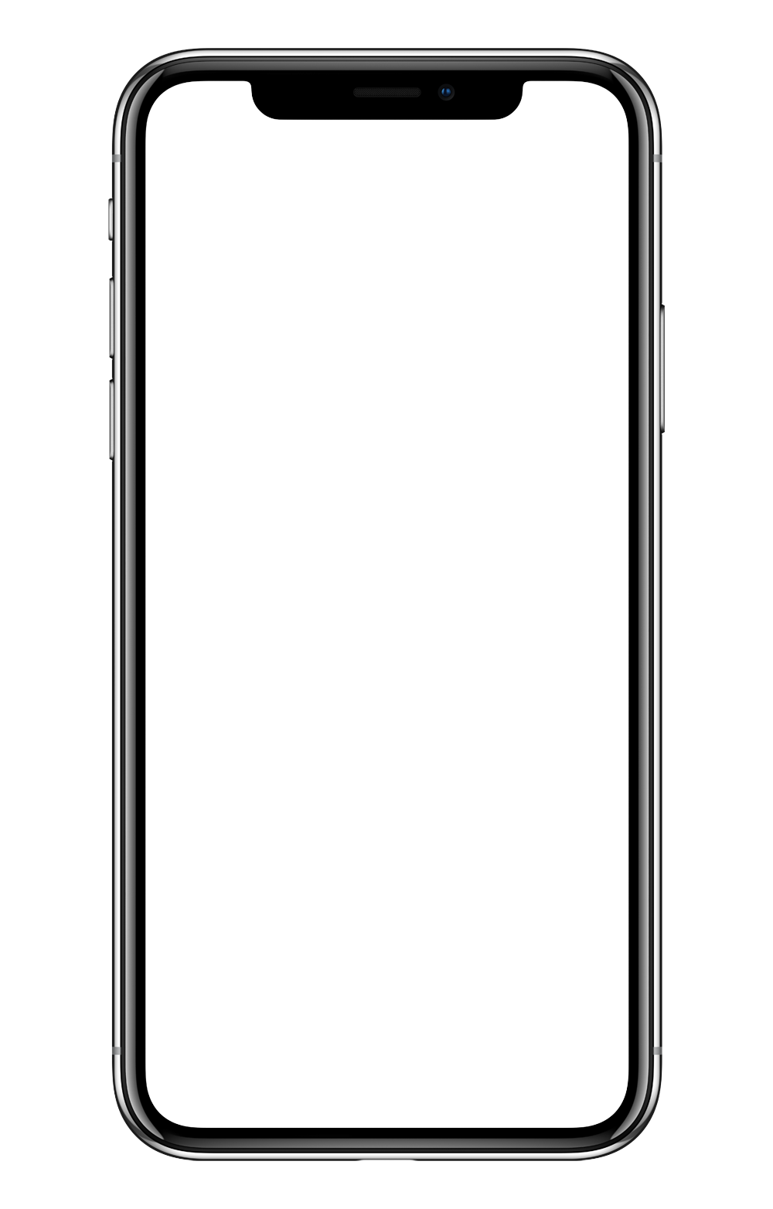
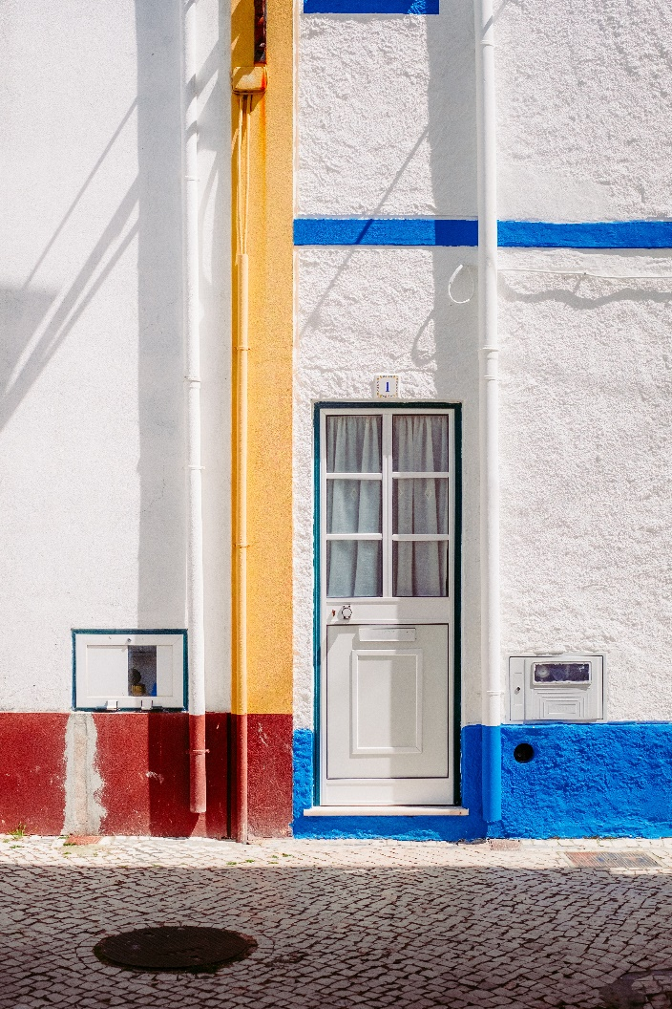
Concise
Style Template
Power Point 2013
I know above the clouds the sun is shining. I design my future bright, not by where my life has been. Not until I do this will my new life start.
NO.1
20$
3,568
Adobe
Windows 10
Illustrator

Slide 20
Concise
Style Template
Google Chrome
Keynote 6.5
I know above the clouds the sun is shining. I design my future bright.
I know above the clouds the sun is shining. I design my future bright.
2015
2016
2017
2018
Power Point 2013
Windows 10
I know above the clouds the sun is shining. I design my future bright.
I know above the clouds the sun is shining. I design my future bright.

Slide 21
Concise
Style Template
Adobe
I know above the clouds the sun is shining. I design my future bright.
I know above the clouds the sun is shining. I design my future bright.
Google
Chrome
Point
Power
I know above the clouds the sun is shining. I design my future bright.
I know above the clouds the sun is shining. I design my future bright.
Illustrator
Power Point 2013
I know above the clouds the sun is shining. I design my future bright, not by where my life has been. Not until I do this will my new life start.

Slide 22
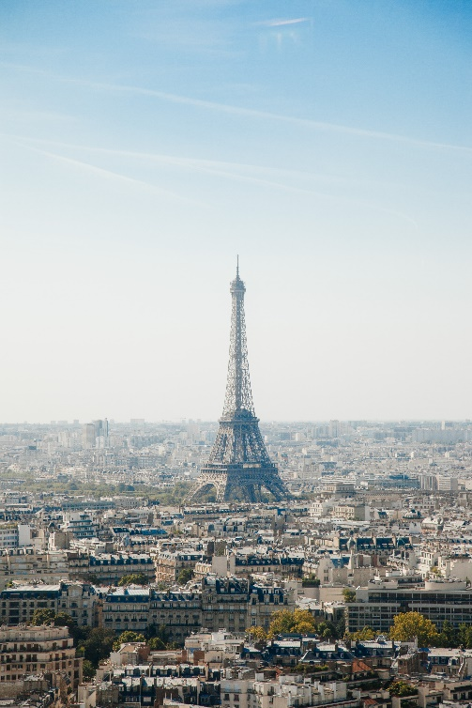
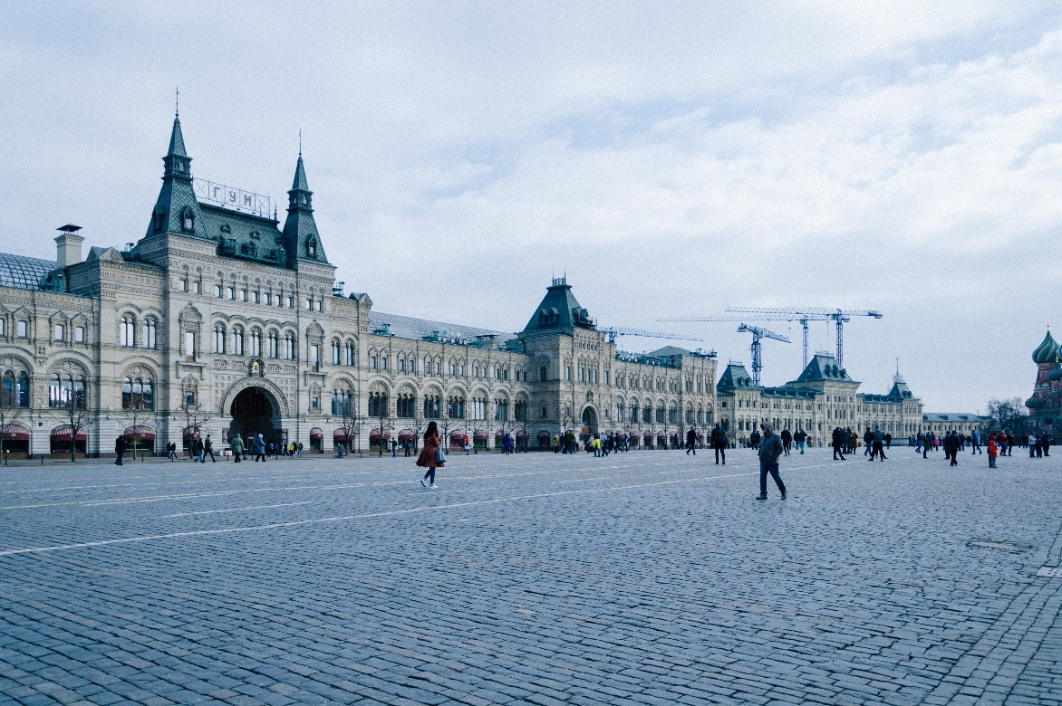
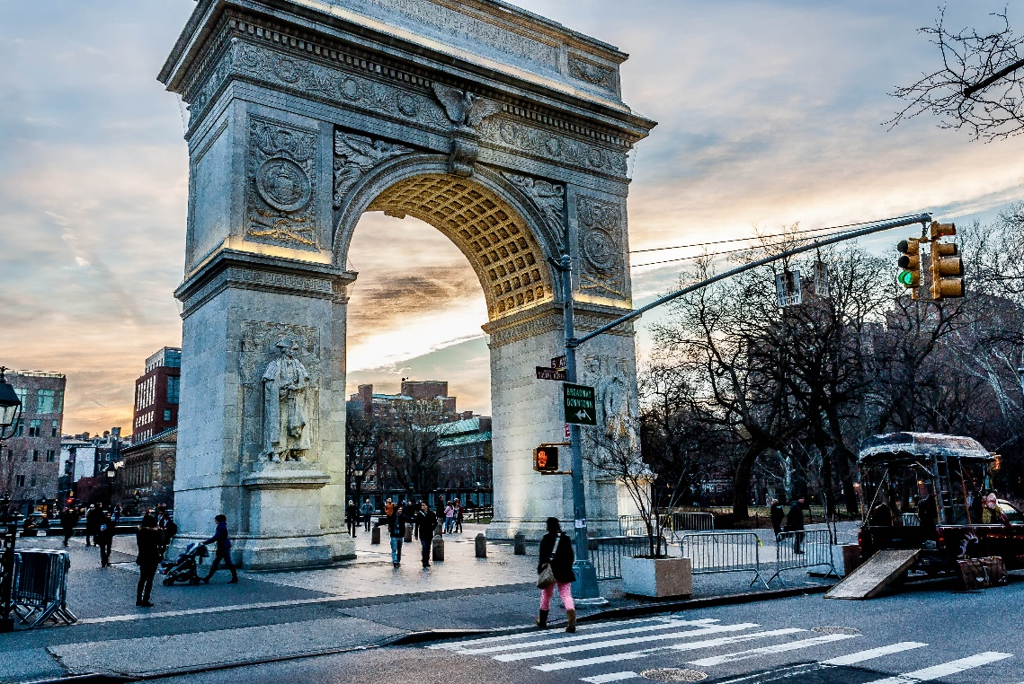
Concise
Style Template
Google Chrome
Windows 10
Keynote 6.5
I know above the clouds the sun is shining. I design my future bright.
I know above the clouds the sun is shining. I design my future bright.
I know above the clouds the sun is shining. I design my future bright.

Slide 23

Our Team
03
Not until I do this will my new life start. And say my thank yous to each and every moment of my life.
Three
POWERPOINT

Slide 24
Concise Style Template
Windows 10
Google Chrome
60%
40%
Man
Women
Google Chrome
I know above the clouds the sun is shining. I design my future bright, not by where my life has been. Not until I do this will my new life start.

Slide 25

Concise
Style Template
Google
Chrome
Windows 10
Keynote 6.5
I know above the clouds the sun is shining. I design my future bright.
I know above the clouds the sun is shining. I design my future bright.
I know above the clouds the sun is shining. I design my future bright.

Slide 26
Concise
Style Template
I design my future bright.
I know above the clouds is shining.
01
03
05
I know above the clouds is shining.
I know above the clouds is shining.
Google
Chrome
Keynote
6.5
I design my future bright.
I design my future bright.
02
04
Windows
10
Point 2013
I know above the clouds is shining.
Adobe Illustrator
I know above the clouds is shining.
I design my future bright.
I design my future bright.
Not Until I Do This Will My New Life Start. And Say My Thank Yous To Each And Every Moment Of My Life.

Slide 27

Our Strategy
04
Not until I do this will my new life start. And say my thank yous to each and every moment of my life.
Four
POWERPOINT

Slide 28
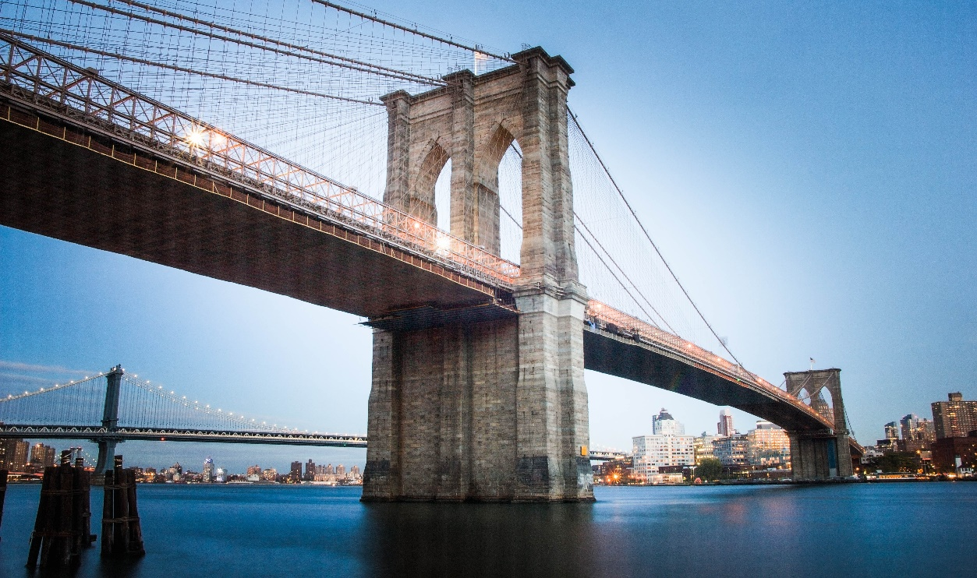



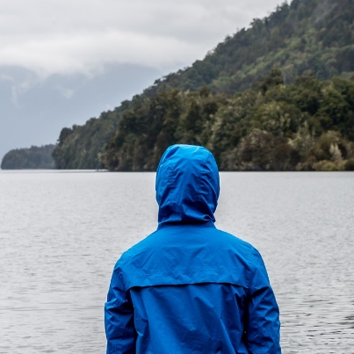
Concise
Style Template
Power Point 2013
I know above the clouds the sun is shining. I design my future bright. Not until I do this will my start.

Slide 29
Concise
Style Template
Adobe Illustrator
Windows 10
Power Point 2013
Keynote 6.5
Google Chrome
I know above the clouds the sun is shining. I design my future bright.
I know above the clouds the sun is shining. I design my future bright.
I know above the clouds the sun is shining. I design my future bright.
I know above the clouds the sun is shining. I design my future bright.

Slide 30
Concise
Style Template
Windows 10
I know above the clouds the sun is shining. I design my future bright.
Keynote 6.5
I know above the clouds the sun is shining. I design my future bright.
Google Chrome
I know above the clouds the sun is shining. I design my future bright.
Not Until I Do This Will My New Life Start. And Say My Thank Yous To Each And Every Moment Of My Life.

Slide 31
Concise
Style Template
Various Artists
I know above the clouds the sun is shining. I design my future bright.
Not until I do this will my new life start. And say my thank yous to each and every moment of my life.

Slide 32


Concise
Style Template
Power Point 2013
I know above the clouds the sun is shining. I design my future bright, not by where my life has been. Not until I do this will my new life start.
Windows 10
Keynote 6.5
Google

